Slide 1


Major Project
Title: Text To Image Generation
Presented by:
Mudit Dagar
BTech CSE AI & ML Batch- 4
500076400
R177219126
Mentored By:
Dr. Virendra Kadyan
Department of Informatics
UPES, Dehradun
Prateek Sherawat
BTech CSE AI & ML Batch- 4
500076579
R177219134
Piyush Malviya
BTech CSE AI & ML Batch- 3
500075183
R177219073
Rahul Dhanola
BTech CSE AI & ML Batch- 4
500075154
R177219139

Slide 2
Content
Introduction
Literature Review
Problem Statement
Objectives
Datasets Used
Model Architecture
Methodology
Timeline
References

Slide 3
Introduction
Text to image synthesis refers to the method of generating images from the input text automatically. Deciphering data between picture and text is a major issue in artificial intelligence.
For generating images, GAN(Generative Adversarial Models) are used. Recent progress has been made using Generative Adversarial Networks (GAN).
In this project, we present a Generative Adversarial Network (GAN), which can generate images based on the text description provided.
In the presented GAN model, the input vector of the Generative network is built based on a noise vector z and another vector containing an embedded representation of the textual description.

Slide 4
Literature Review
There is numerous literature and studies on the application of these algorithms to understand emotions and state of mind from human speech.
1. In the last few years, approaches based on Deep Learning have raised, which are able to synthesize images with varied success. Variational Autoencoders (VAE) [2], once trained, can be interpreted as generative models that produce samples from a distribution that approximates that of the training set.
2. Generative Adversarial Networks (GAN) have gained a considerable amount of interest since its inception, having been used in tasks such as single-image super resolution, Simulated + Unsupervised learning, image-to-image translation and semantic image inpainting.
3. Some approaches to tackle these problems have focused on iteratively refining the generated images. For example, in the Style and Structure GAN (S2 -GAN) model, a first GAN is used to produce the image structure, which is then fed into a second GAN, responsible for the image style. Similarly, the Laplacian GANs (LAPGAN) can have an indefinite number of stages, integrating “a conditional form of GAN model into the framework of a Laplacian pyramid”.

Slide 5
Problem Statement
Generating photo-realistic images from text is an important problem and has tremendous applications, including photo-editing, computer-aided design, etc and this can be achieved by the GAN. These capabilities of GAN motivated us to build a system that will be able to generate fake images based on the input text provided.

Slide 6
Objective
To develop a Text to Image Synthesis system using the Generative Adversarial Networks (GAN) and its calculating the Generator/Discriminator loss over time.
Therefore, the following objectives need to be achieved to satisfy the development of the project.
To study Generative Adversarial Network (GAN) and develop a system that is able to generate images
To detect, extract and recognize image characteristics using Convolutional Neural Network (CNN) and,
To study about Skip-Thought vectors to generate an embedding vector for each of our dataset captions and their corresponding images.

Slide 7
Datasets Used
Dataset: 102 Category Flower Dataset
We are using Oxford-102 dataset of flowersfor the model to learn in generation of any flower image based on its description.
We have created a 102-category dataset, consisting of 102 flower categories. The flowers chosen to be flower commonly occurring in the United Kingdom.
Each class consists of between 40 and 258 images.
Each Image Have its Corresponding Description about what the image is describing about that flower in it.
We have also used the help of a pre trained model which can help in the generation of the thought vectors of each corresponding GAN and that can be then used to train the Generator and Discriminator.

Slide 8
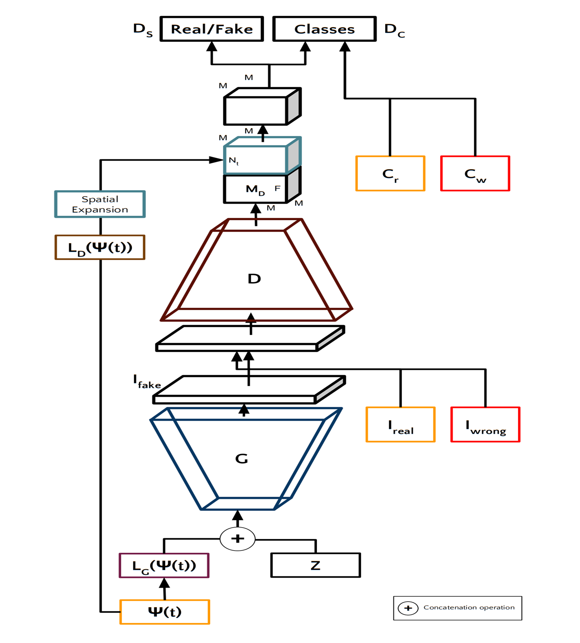
Model Architecture
The architecture of the TAC-GAN. Here, t is a text description of an image, z is a noise vector of size Nz.
Ireal and Iwrong are the real and wrong images respectively, Ifake is the image synthesized by the generator network G, Ψ(t) is the text embedding for the text t of size Nt, and Cr and Cw are one-hot encoded class labels of the Ireal and Iwrong, respectively. LG and LD are two neural networks that generate latent representations of size Nl each, for the text embedding Ψ(t). DS and DC are the probability distribution that the Discriminator outputs over the sources (real/fake) and the classes respectively.

Slide 9
Methodology 4.1 Proposed Method
The proposed system when subjected to a scenario of a set of text description of images (mainly flowers related), the characters in the text description are converted to skip-thought vectors which have the features of the image to be generated and then the vector is passed to the GAN which generates the images based on the features identified by the text.
Generative Adversarial Network is using the stages like pre-processing, feature extraction and recognition using neural network.

Slide 10
Methodology 4.2 System Architecture
A text to image generation system receives an input in the form of text which contains some information about the image to generate. The output of this system is the image generated similar to as described in the text description. There are two Networks:
) Generator Network (G): The Generator Network is very similar to that of the ACGAN. However, instead of feeding the class label to which the synthesized image is supposed to pertain, we input the noise vector z, containing information related to the textual description of the image. In our model, G is a neural network consisting of a sequence of transposed convolutional layers. It outputs an upscaled image If (fake image) of shape 128 × 128 × 3.
Discriminator Network (D):
The Discriminator network is composed by a series of convolutional layers and receives an image I (any of the images from A). By passing through the convolutional layers, the image is down sampled into an image MD of size M × M × F, where M and F are hyperparameters of the model. lr is replicated spatially to form a vector of shape M × M × Nl and is concatenated with MD in the F (channels) dimension.
This concatenated vector is then fed to another convolutional layer with spatial dimension M × M. Finally, two fully connected layers are used with 1 and Nc neurons, respectively, along with the sigmoid activation function. F C1 produces a probability distribution DS over the sources (real/fake), while F C2 produces a probability distribution DC over the class labels. Details of the architecture are described in Figure 1.

Slide 11
Timeline
Our month wise plan to complete the project is as follows
February 2023
Research paper & feasibility understanding of the different methods used in the project.
Gather all the requirements like hardware and software tools and modules for the implementation.
Also collecting & understanding the required datasets.
April 2023
Starting the Implementation part with various pre-processing steps.
Arranging the data according to the model requirements.
Training & testing of the model.
May 2023
Optimizing & tuning the model parameters to increase the model accuracy
Visualization of various approaches for better understanding.
Completion of the Project.

Slide 12
References
1. M.-E. Nilsback and A. Zisserman. Automated flower classification over a large number of classes. In Computer Vision, Graphics & Image Processing, 2008. ICVGIP’08. Sixth Indian Conference on, pages 722–729. IEEE, 2008.
2. C. Doersch. Tutorial on variational autoencoders. arXiv preprint arXiv:1606.05908, 2016
3. D. P. Kingma and M. Welling. Auto-encoding variational bayes. arXiv preprint arXiv:1312.6114, 2013.
4. Nisha Sharma et al, “Recognition for handwritten English letters: A Re- view “International Journal of Engineering and Innovative Technology (IJEIT) Volume 2, Issue 7, January 2013. Access Date:09/07/2015
5. Salvador España-Boquera, Maria J. C. B., Jorge G. M. and Francisco Z. M., “Improving Offline Handwritten Text Recognition with Hybrid HMM/ANN Models”, IEEE Transactions on Pattern Analysis and Machine Intelligence, Vol. 33, No. 4, April 2011

Slide 13
Thank You

